Slide 1
Student Success in an Online Course: A Student Perspective
Melody Buckner • LRC 576 Teacher Research • Spring 2012
http://lrc576.weebly.com/

Slide 2
Introduction to the Research
History
LRC 320 - Teaching with New Technologies
Fully Online Course
Focus on
Course navigation
Learning objectives
Threaded Discussions
Faculty Feedback

Slide 3
Introduction to the Research
Positionality
Preceptor
Instructional Designer
Discussion Facilitator
PhD researcher

Slide 4
Introduction to the Research
Tensions
Confused with Course Navigation
Unclear about Learning Objectives
Frustrated with Discussions
Unsure how to Communicate with Facilitators
Goals
Intuitive Course Navigation
Clarity of Learning Objective
Building Community through Discussions
Quality Feedback from Facilitators

Slide 5
Introduction to the Research
Governing my Gaze
Online Master’s Degree from NAU
Online student lens
Instructional Designer at UA
Assist Faculty
Researcher for New Literacies Studies
Dig deeper into the Student Perspective

Slide 6
Research Questions
What factors in this LRC320 fully online course hinders students from successfully achieving the course goals?
How can the design of the LRC320 fully online course help guide students to the learning objectives/outcomes of the course?
How can the learning objectives help the students achieve the learning goals of the LRC320 course?
How can the online discussions assist students in achieving the learning goals of the LRC320 course?
How does feedback from the faculty, teaching assistant or preceptor help student achieve the learning goals of the LRC320 course?

Slide 7
The Inquiry Process
Site and Demographics
Fully Online Course (LRC320)
Desire2Learn (D2L) CMS
Main Campus UA Students
Juniors or Seniors (19 -23 years old)
Education majors or related fields of study
Spring 2012
Project Based Curriculum

Slide 8
The Inquiry Process
Data Gathering Methods
Mixed Method
Office Hours Notes (Qualitative)
About 15 students
Online Survey (Quantitative)
17 students
Recorded Interviews (Qualitative)
4 students

Slide 9
The Inquiry Process
Data Analysis
From the Office Hours Journal categorized
issues
word patterns
trends
From the interviews, added to these categories
From survey, highlighted results that fit into the original categories
Used Triangulation from the three sources to verify my findings

Slide 10
The Inquiry Process
Narrowing
17 surveys collected out of 60
4 interviews conducted
Focused on one major issue students were having with the course
The Website Assignment

Slide 11
Bring It All Together
Share My Story
My Theoretical Framework
Malcolm Knowles – Adult Learning Theory
Benjamin Bloom – Learning Cognitive Taxonomy
Jerome Bruner – Constructivist Theory
Inspirational Quote from How Learning Works
“Learning is a process, not a product. Learning involves change in knowledge, beliefs, behaviors, or attitudes. Learning is not something done to students, but rather something students themselves do” (p.3).

Slide 12
Bring It All Together
Share My Story
My Findings
The main issue is one assignment – the website.
From Office Hours
The words used:
difficult, frustrating and confusing
Phases used:
Where do I begin?
How do I do this?
What am I graded on?

Slide 13
Bring It All Together
Share My Story
Interview
“I wish I could have learned more relevant data concerning websites. I don’t think going through all this rigmarole (the U-Account) is as necessary as it should be.”
she had “some difficulty with the website assignment, she learned quite a bit and the course met her expectations”.
“I will definitely use the webpage, which I can tell people and that is kind of cool. So for my own classroom I can make my own webpage…”

Slide 14
Bring It All Together
Share My Story
Survey
this was an extremely difficulty course for those of us who have never made a website.
“I felt like a fish out of water with little or nothing to go on.”
“ Once I was given aid and instructions (verbally), the website assignment and course materials were easy to understand and implement.”
Statistical Data
Scored the course to be average in most categories

Slide 15
Bring It All Together
Share My Story
Conclusion
The website assignment proves to be difficult for students not familiar with technology.
There were technical difficulties in regard to the website assignment that we could avoid by revising the assignment.
We need to focus less on the technical side of website development and more on the implementation of websites for classroom use.
Instructions need to be clear and delivered through various methods.

Slide 16
Bring It All Together
Share My Story
Conclusion
Course navigation is effective, but pay attention to broken link and stay current.
Learning objectives were helpful in making the modules meaningful
Discussions did contribute to the overall experience of the course especially when relevant material was shared.
Last quote that sums it up well:
“ It is a great course and with some minor adjustments…it might be one of my favorite courses I have taken at UA.”

Slide 17
Epilogue
What’s next?
More research with future LRC 320 students!
Keep on talking with students about their experience in the course.
Keep updating the course to reflect the student’s suggestion.
Formative evaluations of courses midway through the semester and fostering changes to reflect these insights empowers students to believe they are taking part in their own learning experience and environment.

Slide 18
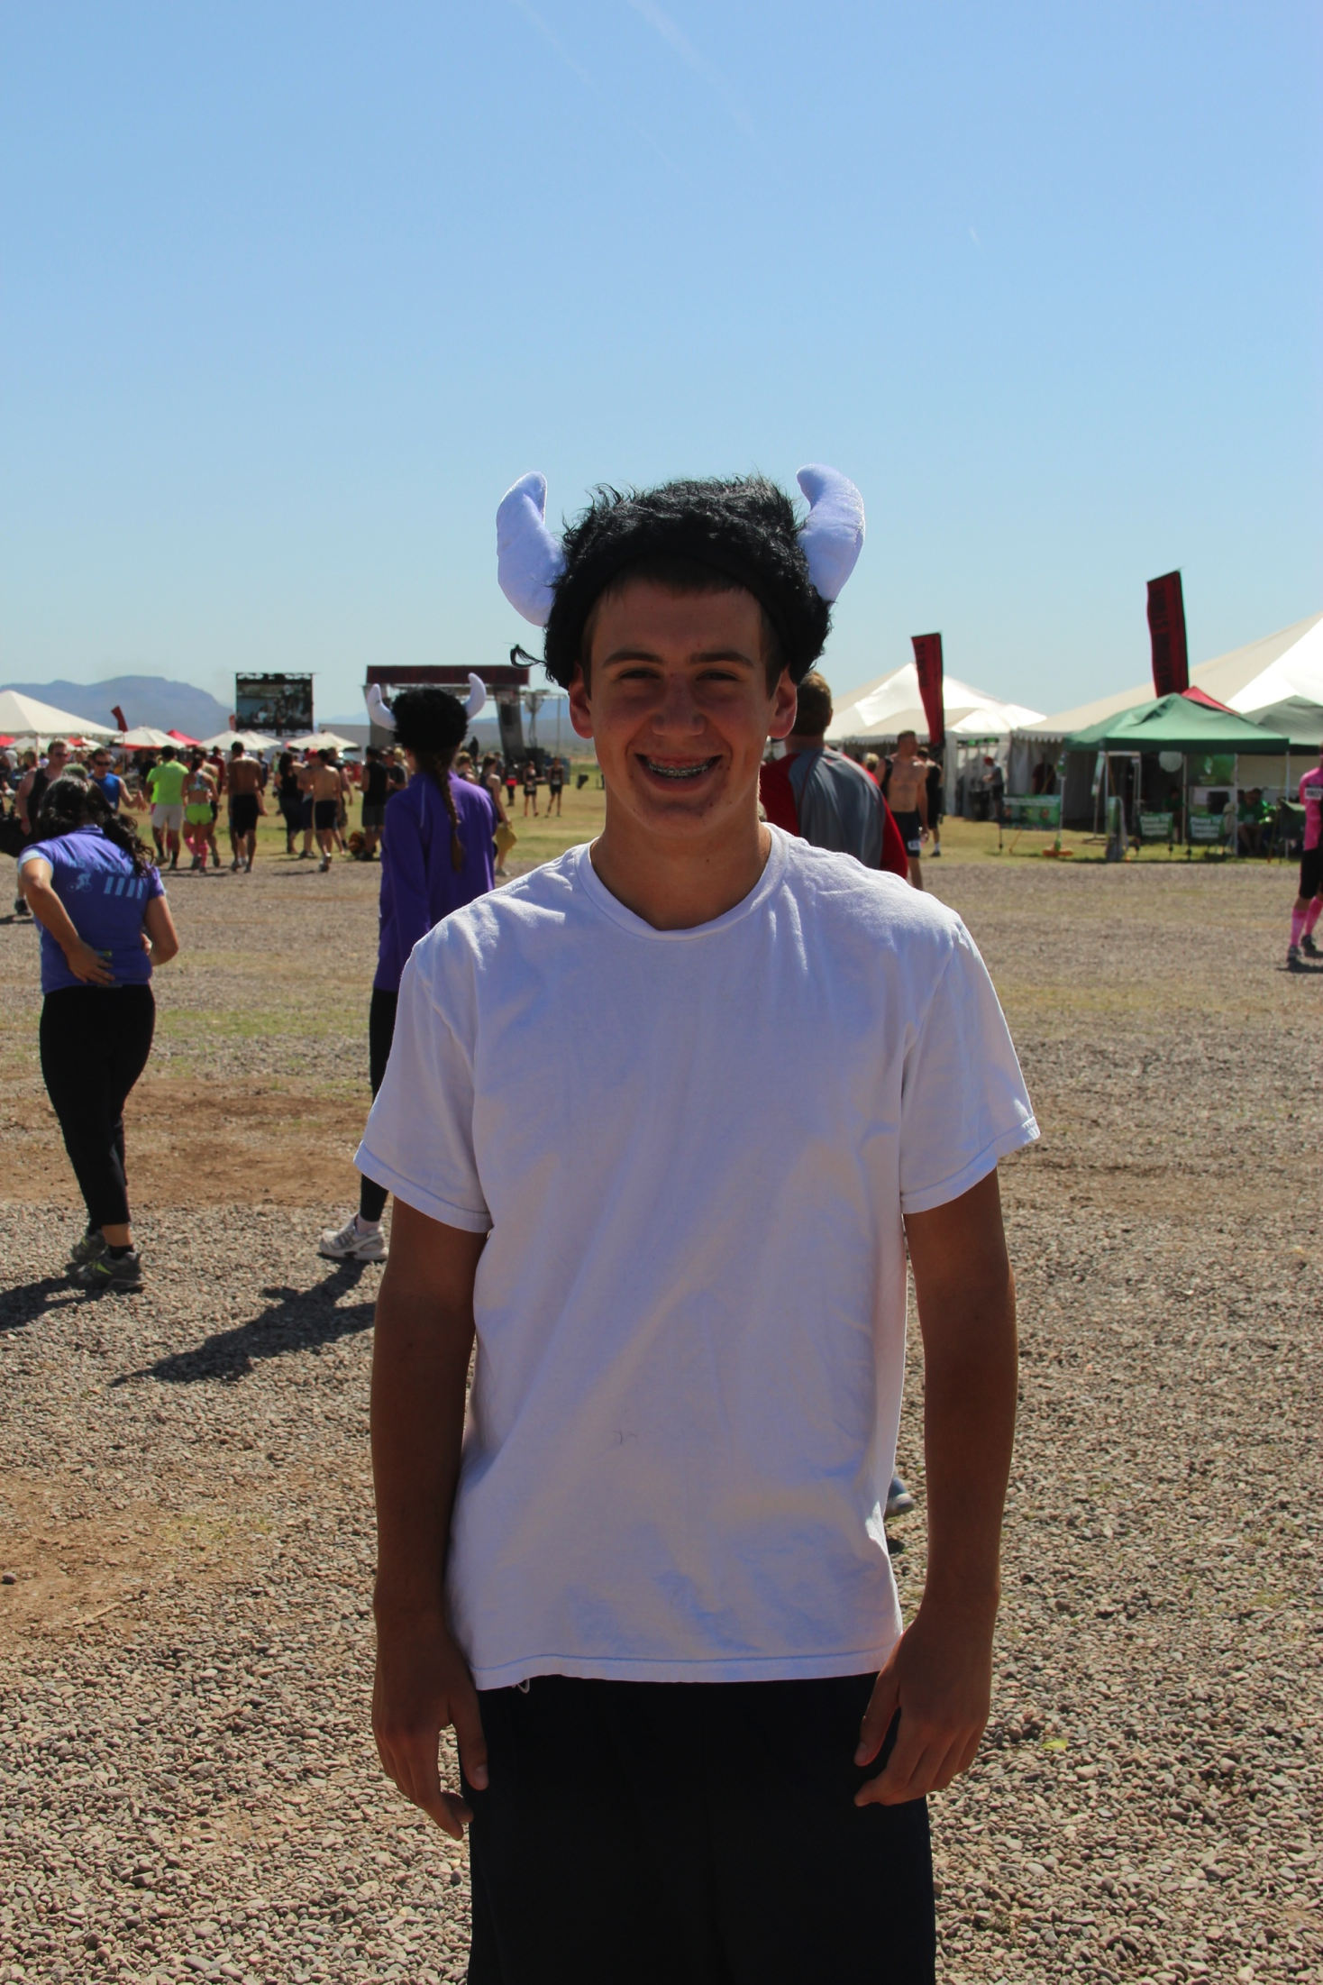
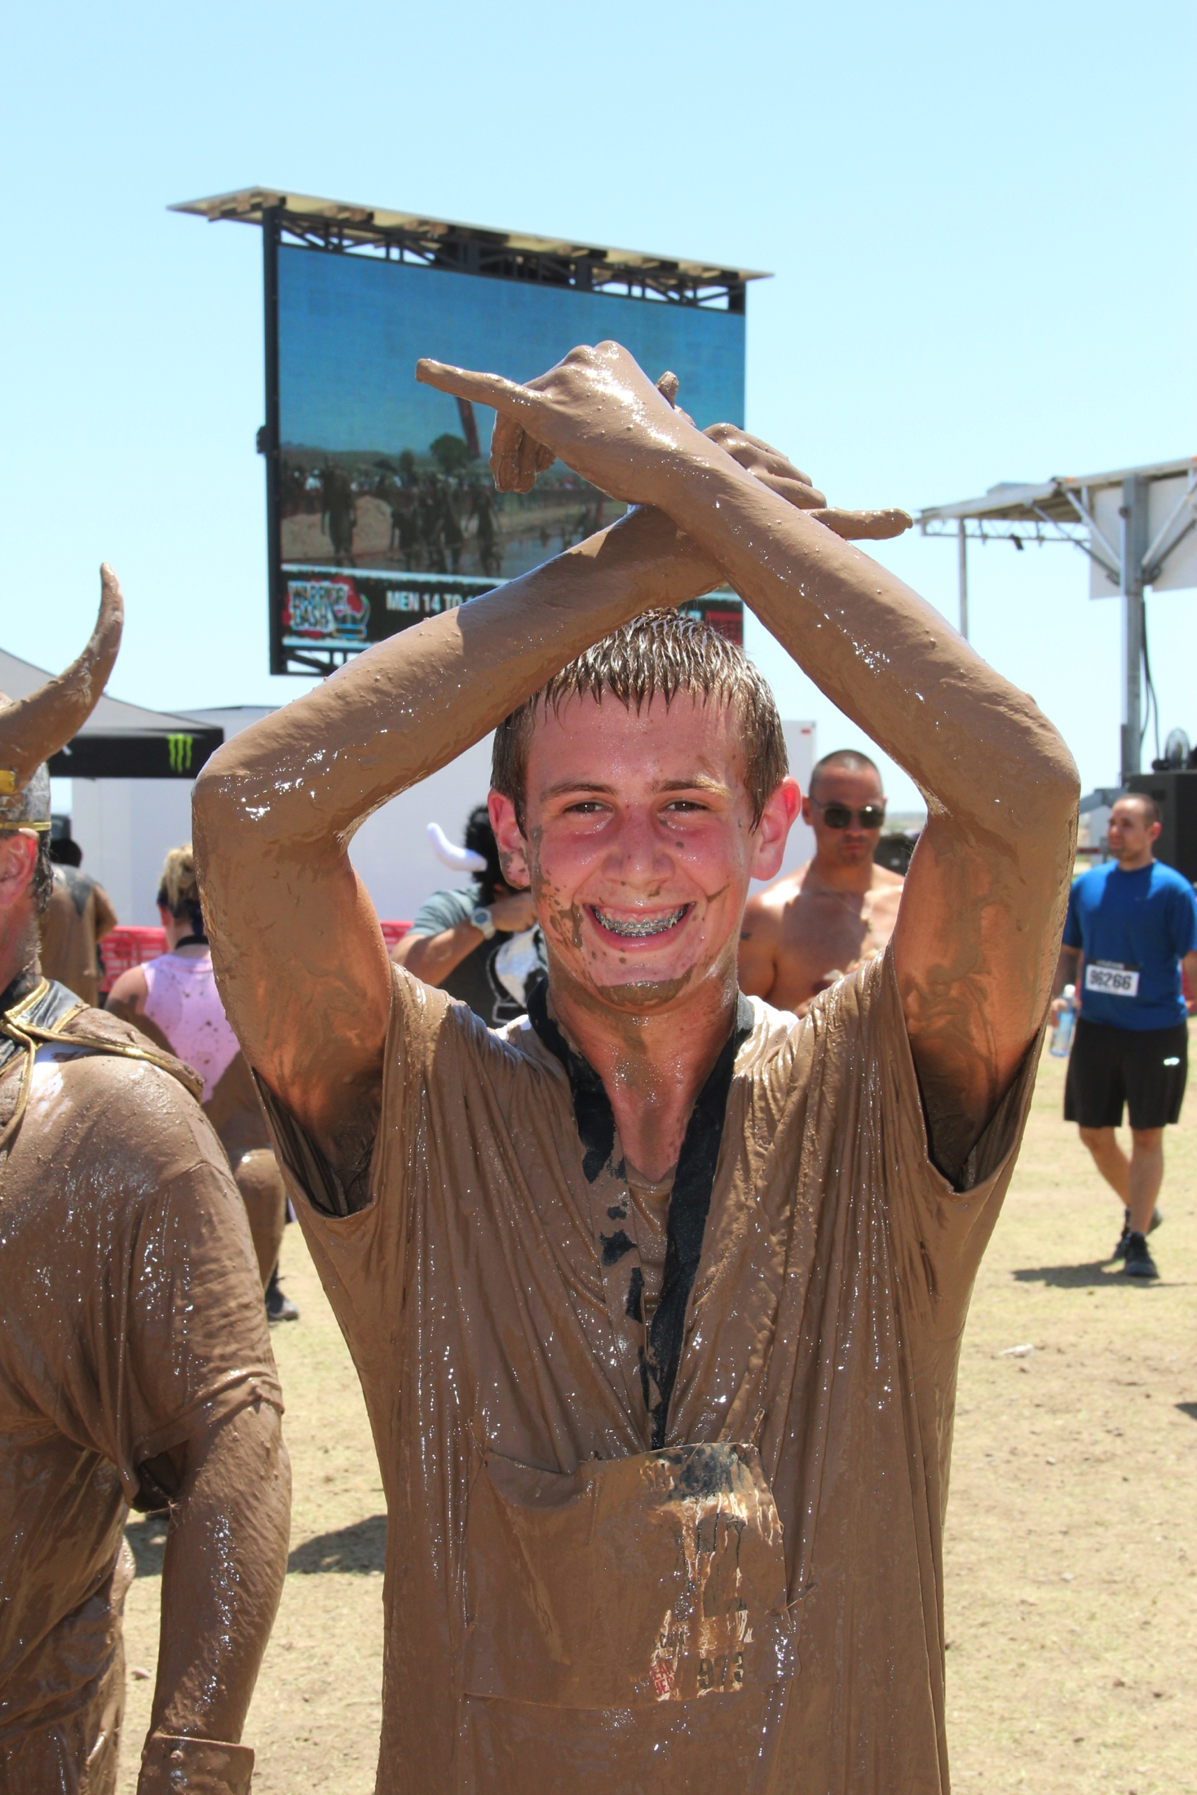
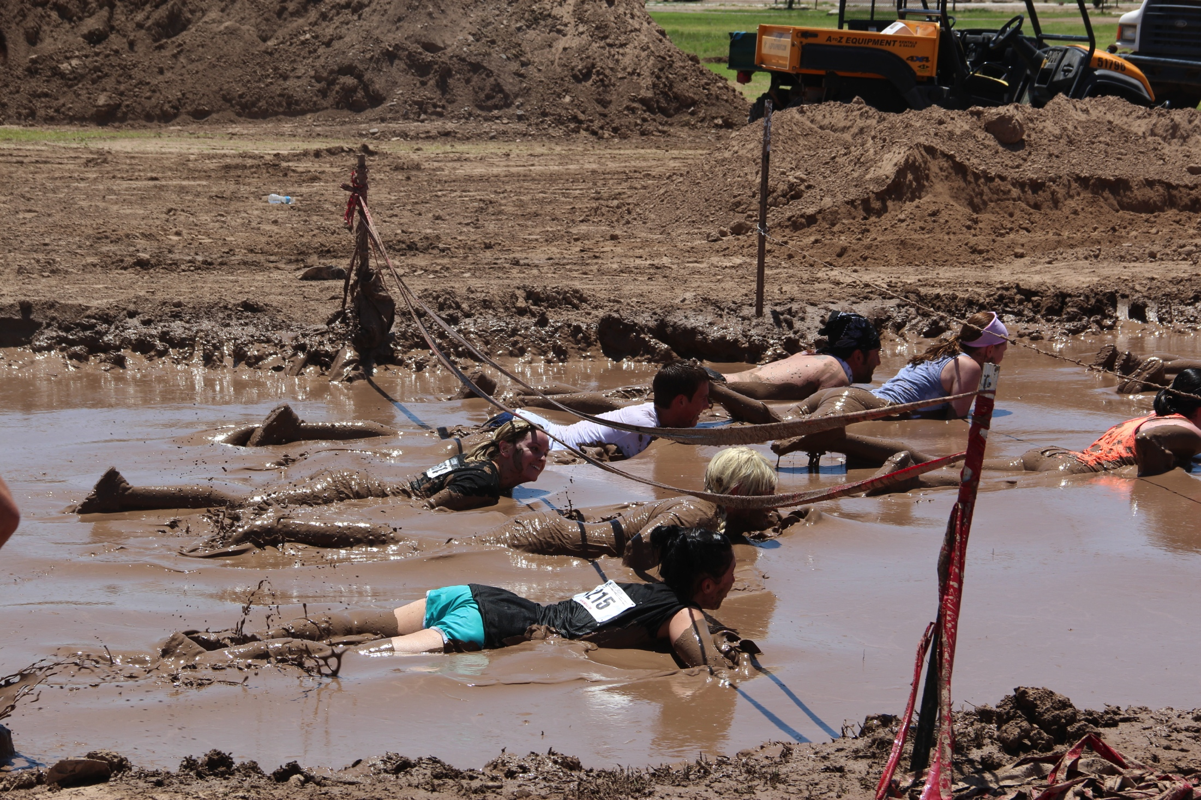
Warrior Dash Champion

